Slide 1
UNIFIED DIAGNOSTIC SERVICE CLEAR DTC INFORMATION 0X14
PRESENTED BY
K.NARAYANA MURTHY(69912)

Slide 2
INTRODUCTION TO UDS PROTOCOL :
UDS – Unified Diagnostics Services.
Unified represents International standards.
UDS protocol allows the Diagnostic systems to communicate with ECU’s to diagnose faults , calibrate sensors and reprogram the ECU’s.
This protocol is defined in ISO-14229 -1 standard and it design based on OSI.
As on date , all the Tier-1 supplier should be using this communication protocol.

Slide 3
Introduction to dtc :
DTC – Diagnostic Trouble Code.
In DTC information get stored in a “ non-volatile “ memory.
In DTC format identifiers are 0016 and 0416; and c.
In DTC there are over 5000 OBD2(On-Board Diagnostic II) Trouble codes.
DTC fault codes are stored in PMC (Programmable Metallization Cell) memory.

Slide 4
Diagnostic message types :
Request without sub-function byte or Positive response.
Request with sub-function byte.
UUDT (Unacknowledged Un-segmented Data Transfer).
Negative response.

Slide 5
Services without sub-function bytes are :
S14 ( clear Diagnostic Information)
S23
S24
S2A
S2E
S2F
S34
S35
S36
S37
S3D
S84

Slide 6
Service s14 :
S14 is one type of a Diagnostic service used to clear Diagnostic Information .
The Mnemonic of S14 is CDTCI .
This Diagnostic service used by the diagnostic tool to clear the DTC(Diagnostic Trouble Code) from the servers memory .
DTC is a fault code stored in memory for faulty control units .

Slide 7
How do you clear the dtc in uds :
We have to add the DTC code which you want to clear .
For example :
I have stored some data in UDS and the data be like 30AAA2A3 .
Now I want to clear that data then,
I have to send a request like > 14 30 AA A2 A3 >.
Then the data will be cleared or deleted on that UDS.

Slide 8
Clear diagnostic uds frame format :
UDS FRAME | D0 | D1 | D2 | D3--------Dn(optional)
Request frame | 0x14 | DTC bytes or Application specific data
Positive response frame | 0x14+0x40 | Application Specific Data
Negative response frame | 0x7F | 14 | YY | Application specific data

Slide 9
Thank you

Slide 10
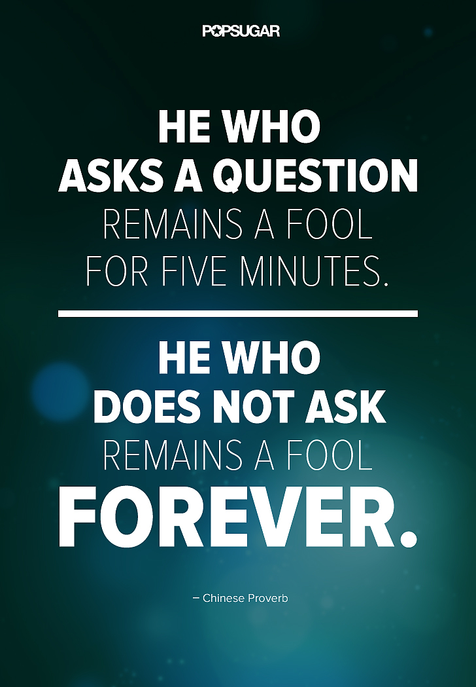
Any queries

